Slide 2
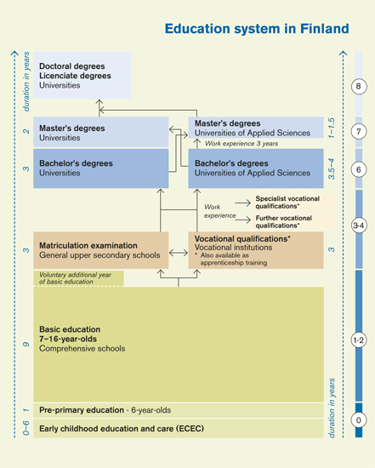
Education System in Finland

Slide 3
The Finnish education system
All teaching is based on national curricula
Cities and municipalities and even individual schools draft their version of the national curriculum
Schools and teachers are relatively autonomous
Compulsory education applies to all 6–18-year-olds. It includes pre-primary, basic and upper secondary education.
Our main value is equality:
Education is free of costs
Multiple ways to achieve higher education
Integration of immigrants and special needs pupils
Relatively few substantial national standardized tests
Matriculation examination at the end of general upper secondary education
http://www.oph.fi/english/education_system

Slide 4
Vocational education
Basic vocational qualification, 180 credits
145 credits vocational studies, incl. on the job –learning(s)
35 credits common studies:
Communication and interaction skills, Mathematics and natural science, Skills required in society and working life
In 2018, the vocational education in Finland underwent a reform:
More personalized learning
Quicker routes to a profession
Recognition of previous skills and knowledge
More skill-based approach

Slide 5
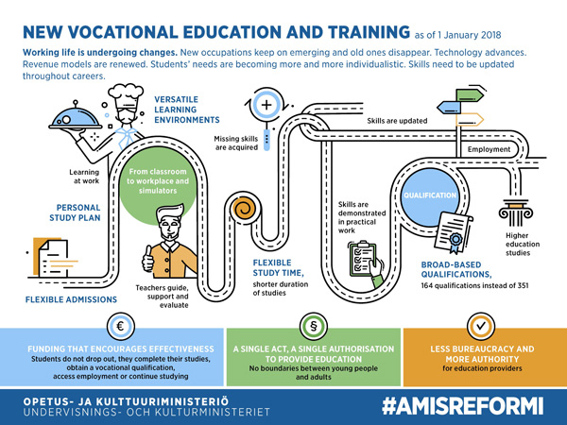
Video

Slide 6
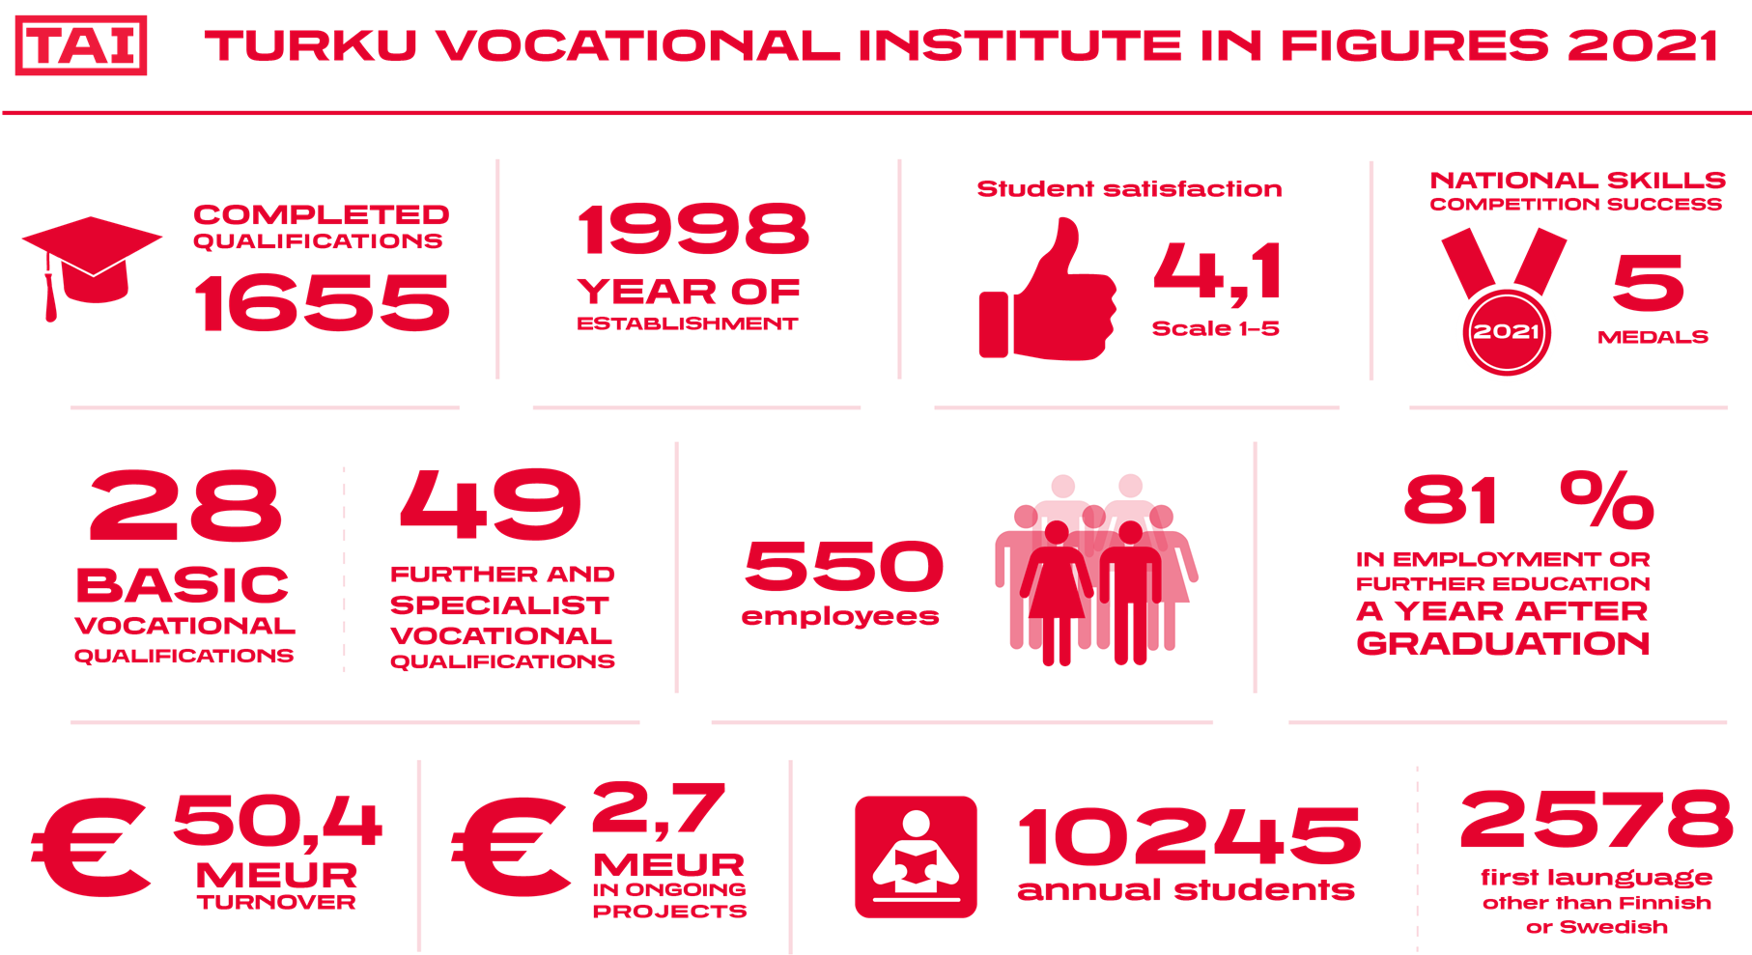

Slide 7
Turku Vocational Institute
Maintained by the City of Turku
28 different basic vocational qualifications for both youth and adult learners
Vocational further education and training, apprenticeship contract education
Languages of instruction: Finnish, Business & Administration and IT studies also offered in Swedish
Specialized studies for immigrants with extra Finnish lessons
Over 10000 students
550 personnel

Slide 8
Turku Vocational Institute
6 locations around Turku
Aninkainen
Juhannuskukkula
Lemminkäinen
Peltola
Kuormakatu
Ruiskatu
Current composition established in 1998

Slide 9
Turku Vocational Institute
Aninkainen campus
Vocational qualification in Food Production
Competence area of Food Technology, Foods Maker
Competence area of Baking, Baker­Confectioner
Competence area of Meat Processing, Meat Products Processor
Vocational Qualification in Restaurant and Catering Services
competence area of customer service (waiter/waitress)
competence area of food services (cook)
Lemminkäinen campus
Vocational Qualification in Restaurant and Catering Services
competence area of customer service (waiter/waitress)
competence area of food services (cook)

Slide 10
TAI Learning Environments
Students can acquire competence in different manners:
in practical and theoretical classrooms
Companies
physical and virtual learning environments.
Physical learning environments allow students to train with authentic tasks and customers while safely supported by close educational guidance. These facilities provide realistic working experiences to our students prior to and in between testing their skills in companies as well as valuable services to the community and the region.

Slide 11
TAI Learning Environments
Aninkainen and TAITO teaching restaurants and conference facilities
TAI restaurant and catering students train in lunch and conference catering and customer service at our two teaching restaurants offering lunch to outside customers daily.
Hostel S/S Bore
Our students run the reception, breakfast and lunch catering along with the conference and meeting services.
Wisio entrepreneurship learning center
Café Wisio: café and a sales point for our restaurant and food industry students’ products

Slide 12
TAI International Activities
Focus on KA1 Erasmus + projects, some KA2 student exchange projects
Global mobility networks funded by The Finnish National Agency of Education: India, China, Nepal, Uganda, Namibia, Tansania, Japan, Canada, Thailand
Outgoing student mobilities: approximately 70-100/year
Outgoing staff mobilities: approximately 30/year
VET Skills - Turku Vocational Institute’s students participate actively in national and international skills competitions.
International Affairs Staff:
Coordinator of International Affairs
6 International Contact Teachers
Manager of International Affairs and Planner of International Affairs of the City of Turku Education Division

Slide 13
Thank you!

